Slide 1
Terrain Analysis using GIS
Sulochan Dhungel
04/07/2022

Slide 2
Overview
Watershed delineation (Intro) – 5 min
How does GIS do it? – 10 ~ 15 min
Steps to be followed (as GIS demo) – 10 min
Limitations of this approach – 5 min
Tool created (as demo of the tool) – 10 ~ 15 min
Some other uses of terrain analysis tools – 5~10 min

Slide 3
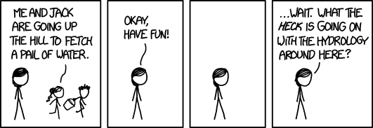

Slide 4
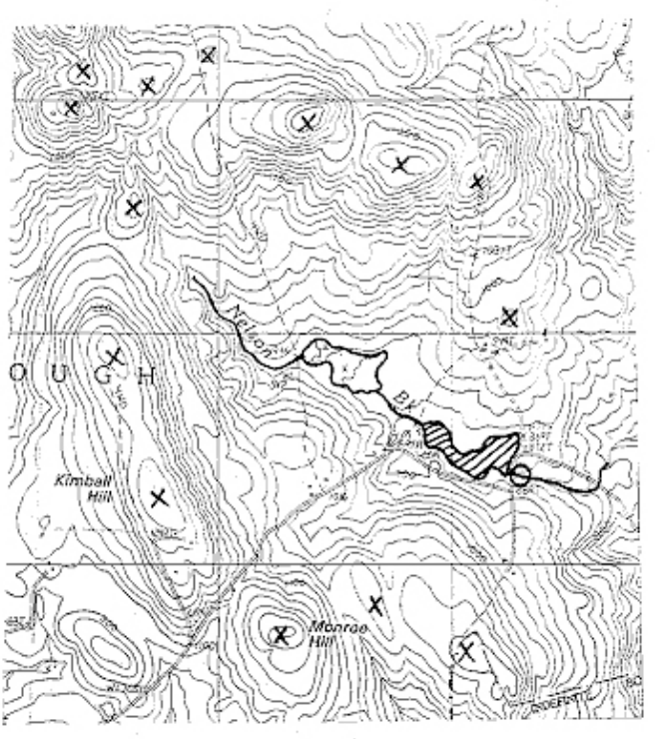
How to delineate a watershed
Step 1: Draw a circle at downstream outlet
Step 2: Draw small X’s at high points, ridge lines and saddles
2
1
USDA guidelines to delineate a watershed

Slide 5
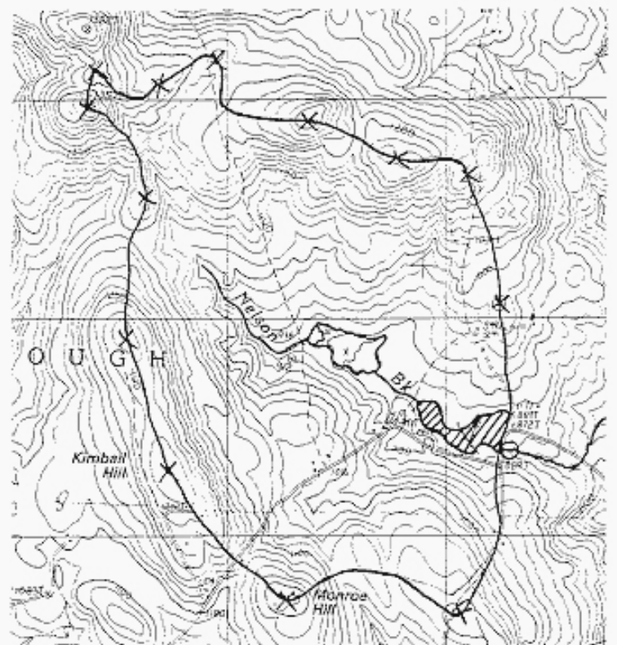
How to delineate a watershed
Step 1: Draw a circle at downstream outlet
Step 2: Draw small X’s at high points, ridge lines and saddles
Step 3: Draw a line starting at circle through these points which crosses each contour line at right angles until you get back to the circle
3
USDA guidelines to delineate a watershed
Notes:
Many times, this could be adequate.

Slide 6
Watershed
Any drop of water that falls in the watershed reaches the outlet!
3
USDA guidelines to delineate a watershed
Notes:
Many times, this could be adequate.

Slide 7
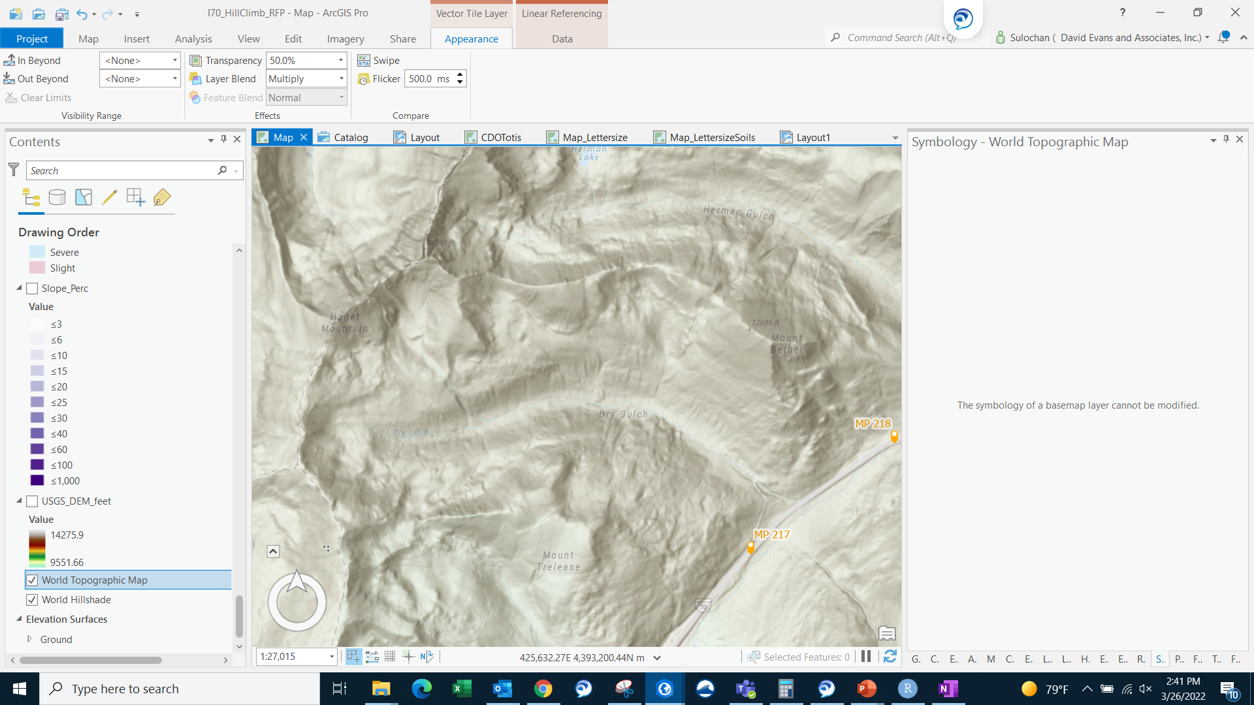
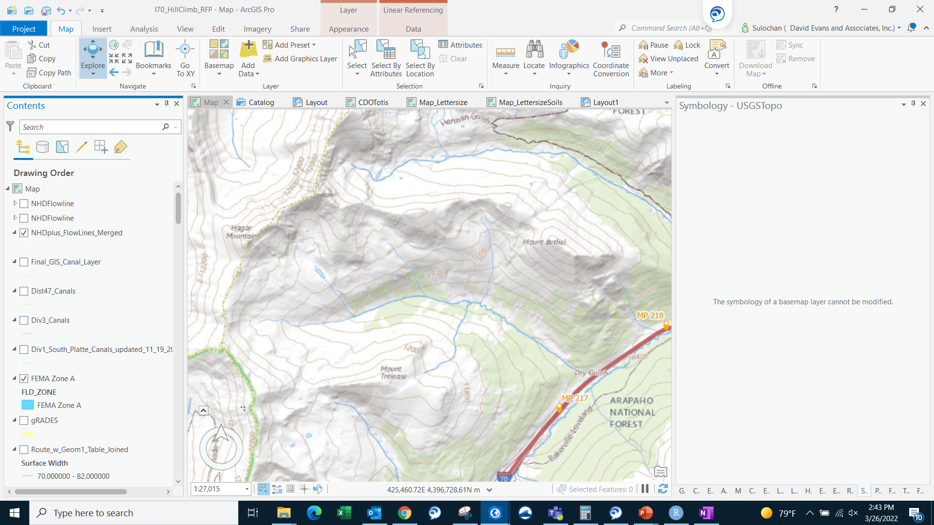
Better data and visualization has made it easier
ESRI Topo with hillshade
USGS Topo with contours and hillshade

Slide 8
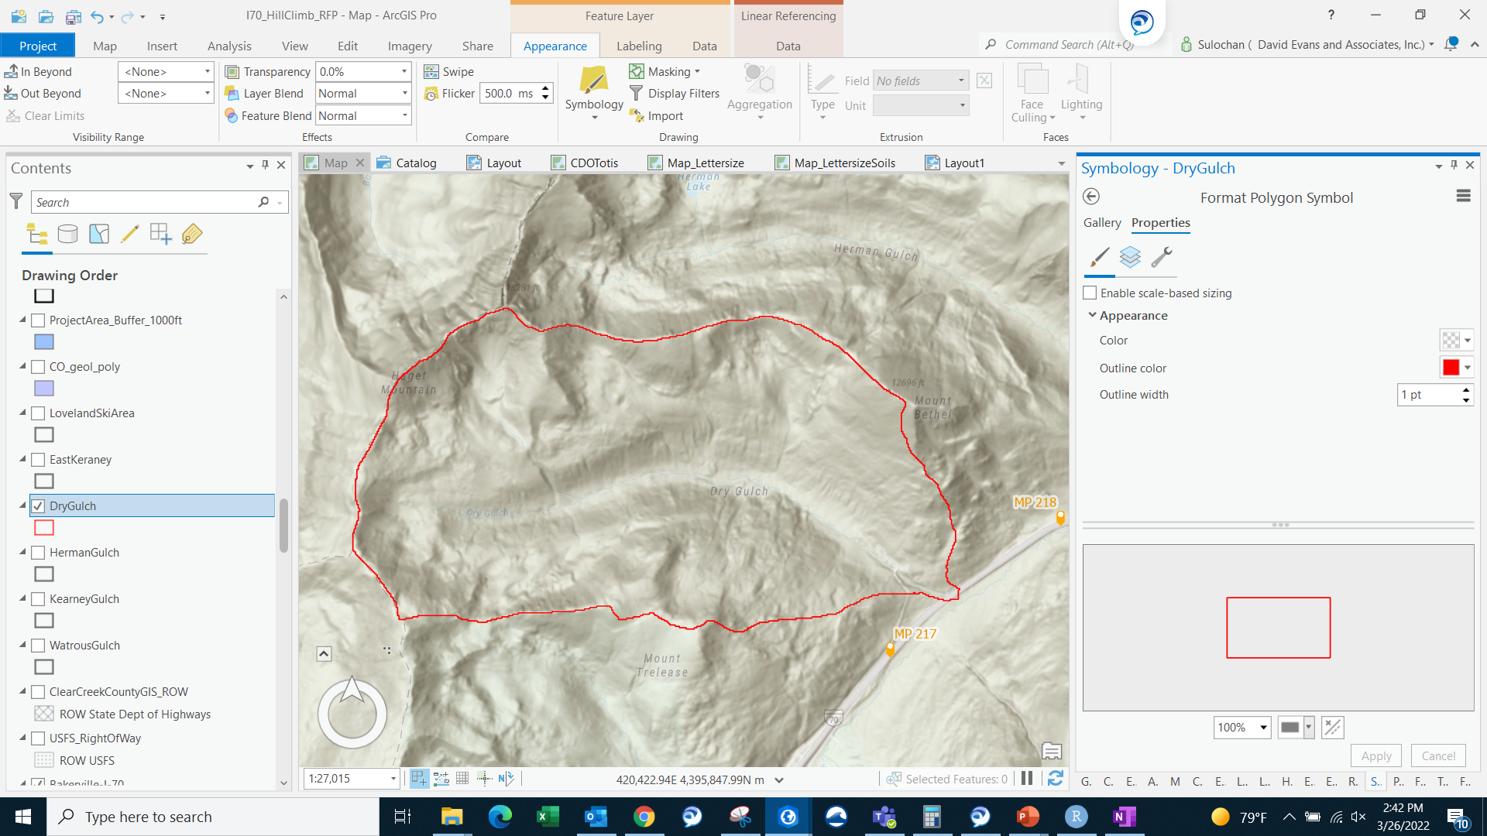
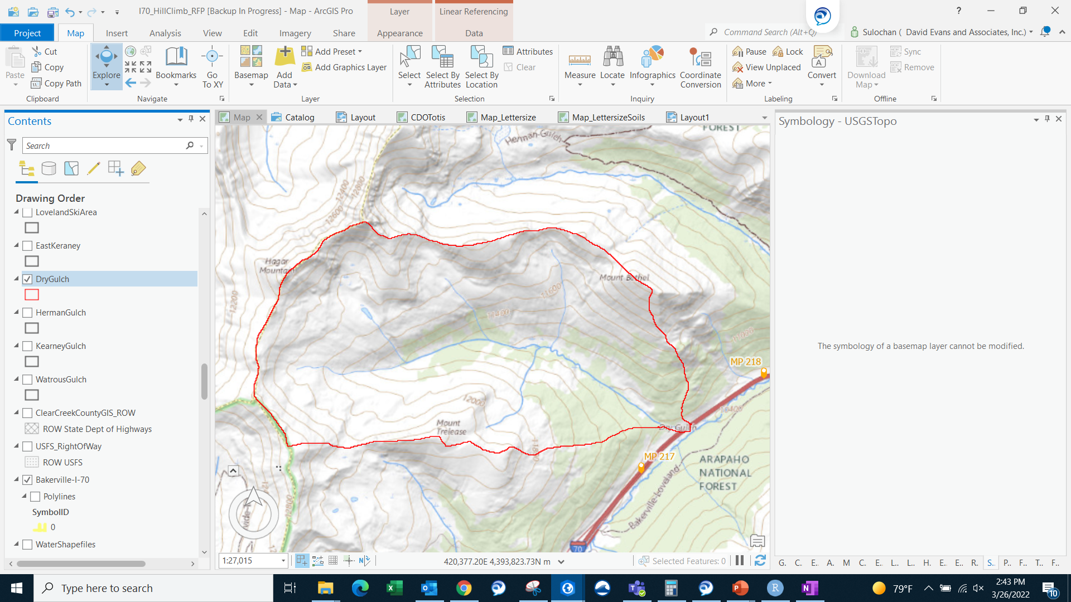
Better data and visualization has made it easier
ESRI Topo with hillshade
USGS Topo with contours and hillshade

Slide 9
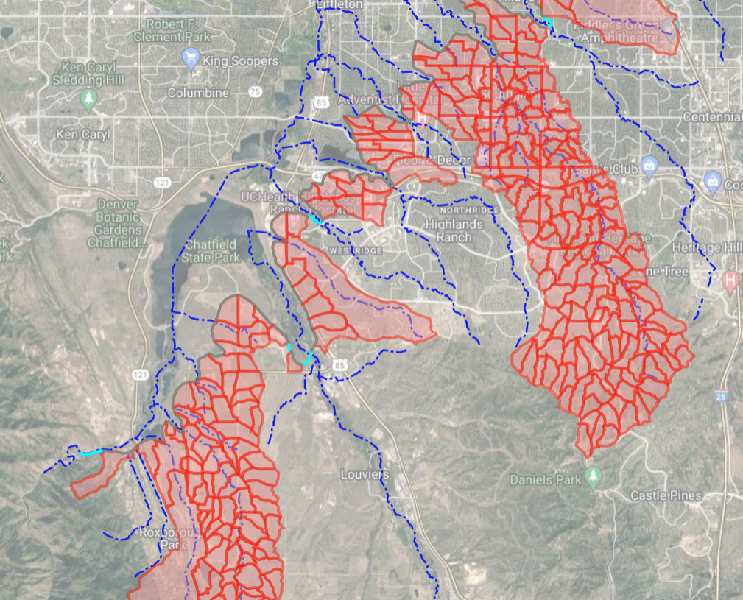
Where is GIS useful?
When there are a lot of watersheds to be delineated
Figure from Highline Canal Stormwater Masterplan project
Notes:
This is a figure which shows watersheds delineated for Highline canal stormwater masterplan project.

Slide 10
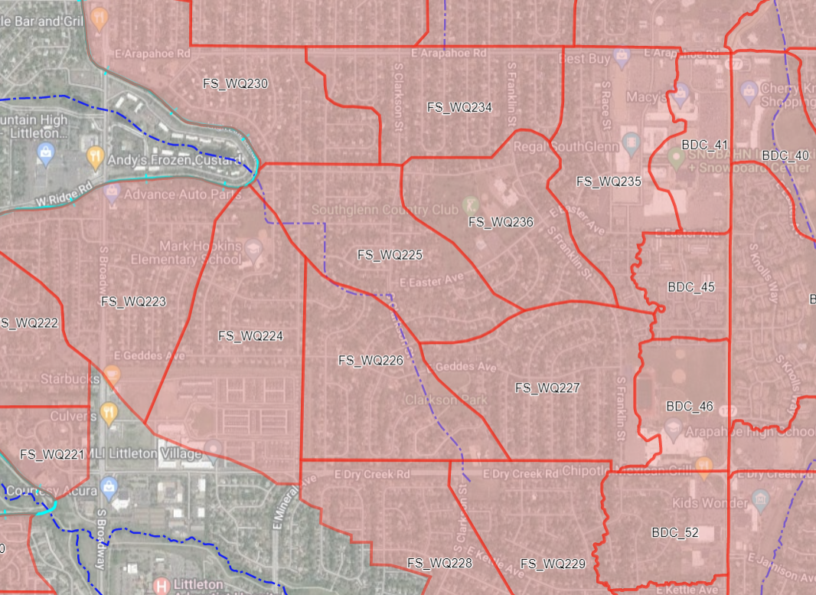
Where is GIS useful?
When there are a lot of watersheds to be delineated
In urban areas where topographical high points are difficult to ascertain and takes a long time
Figure from Highline Canal Stormwater Masterplan project
Notes:
This is a figure which shows watersheds delineated for Highline canal stormwater masterplan project.

Slide 11
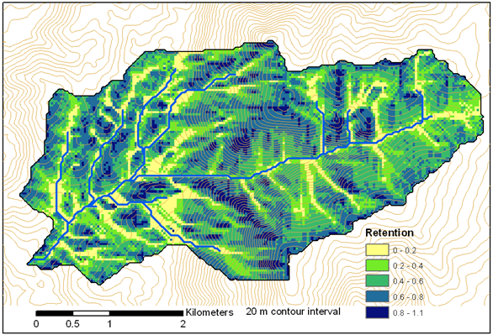
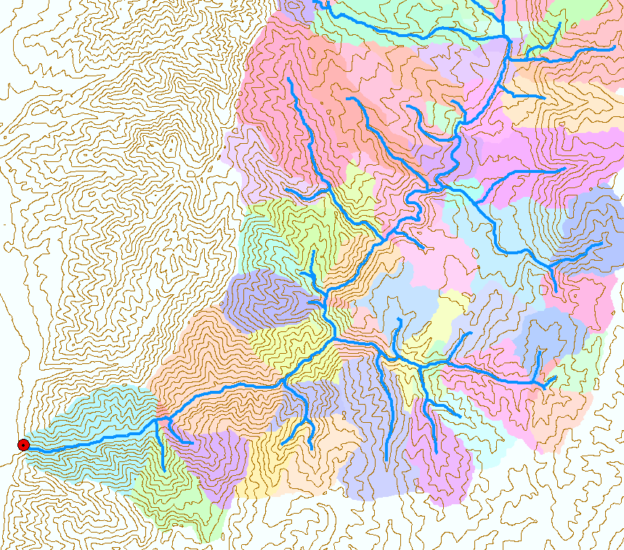
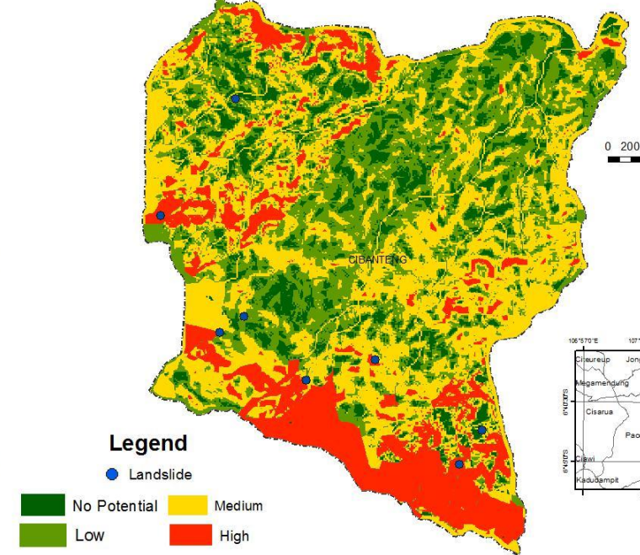
Where is GIS useful?
When there are a lot of watersheds to be delineated
In urban areas where topographical high points are difficult to ascertain and takes a long time
GIS approach enables derivation of variety of information useful for hydrological and geomorphological processes and model inputs
Notes:
Water retention after rainfall, Drainage densities of sub-watersheds, stability index mapping of landslides and much more

Slide 12
Terrain data (Contours)
Contours: Build using Triangular Irregular Network (TIN)
Notes:
We’ve seen contours and we have see that they’re built using TINs

Slide 13
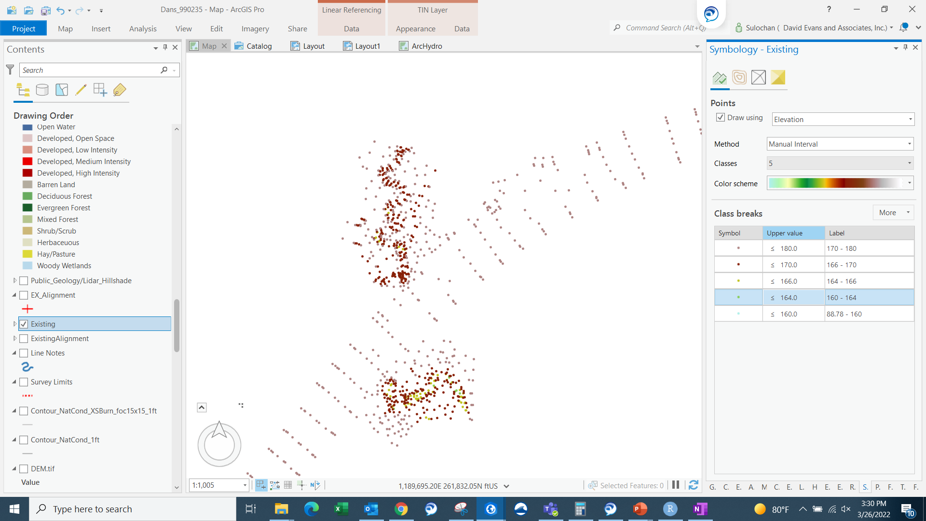
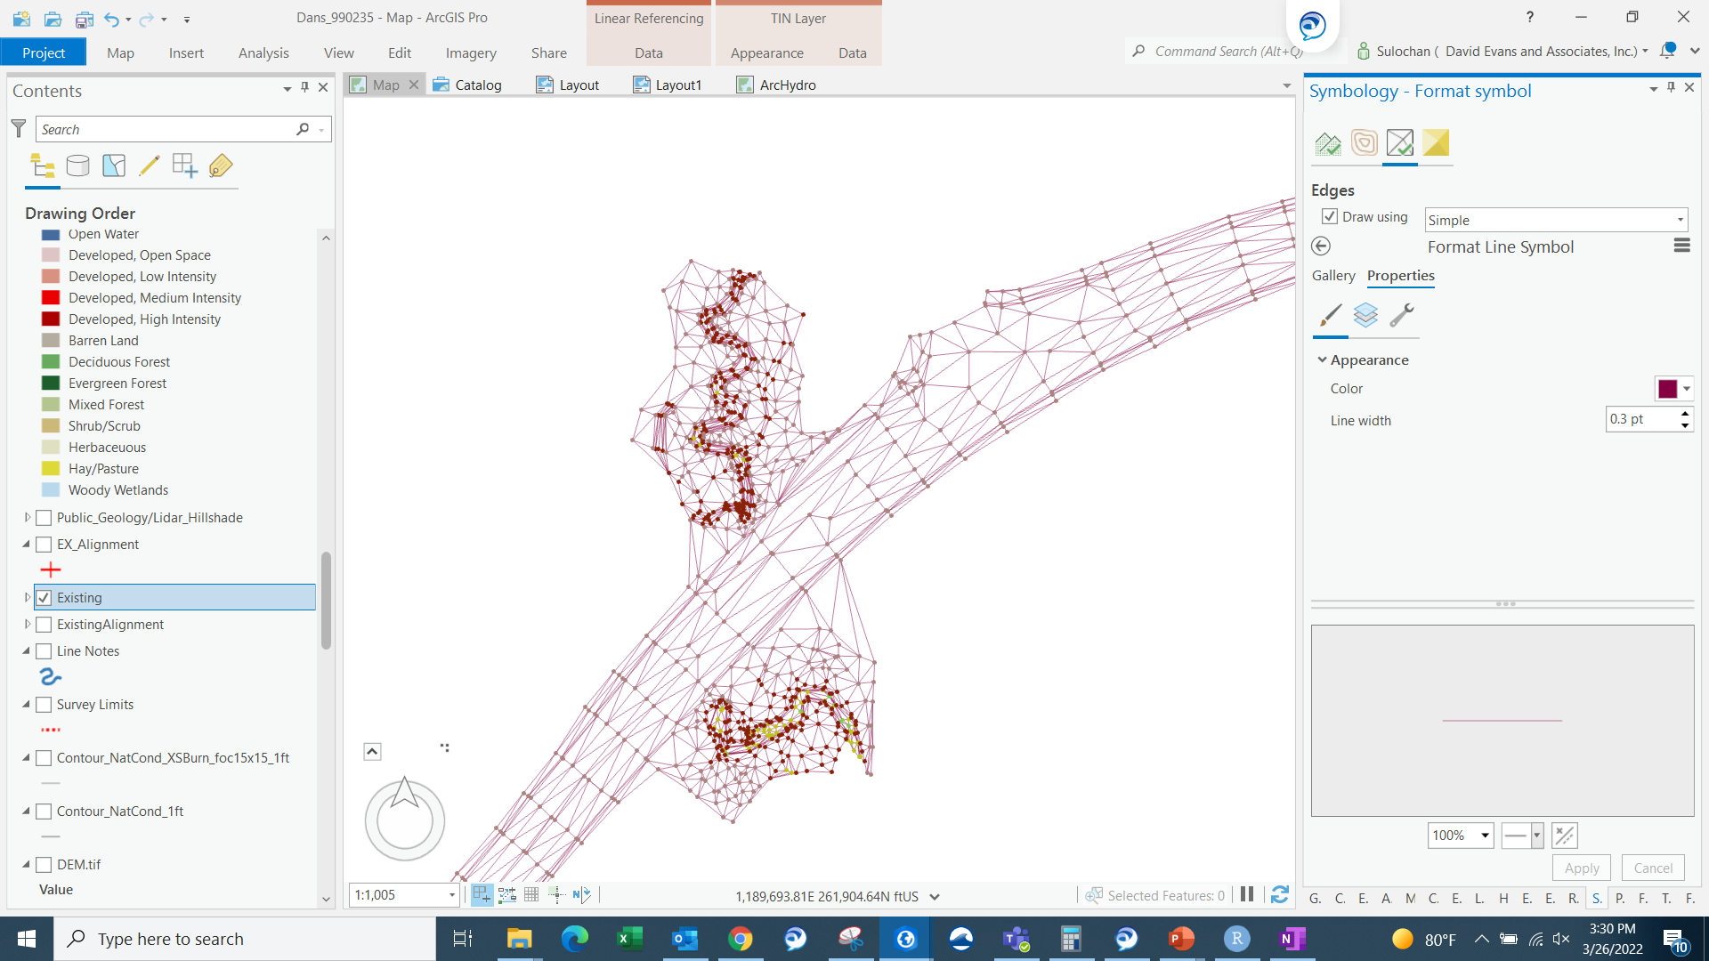
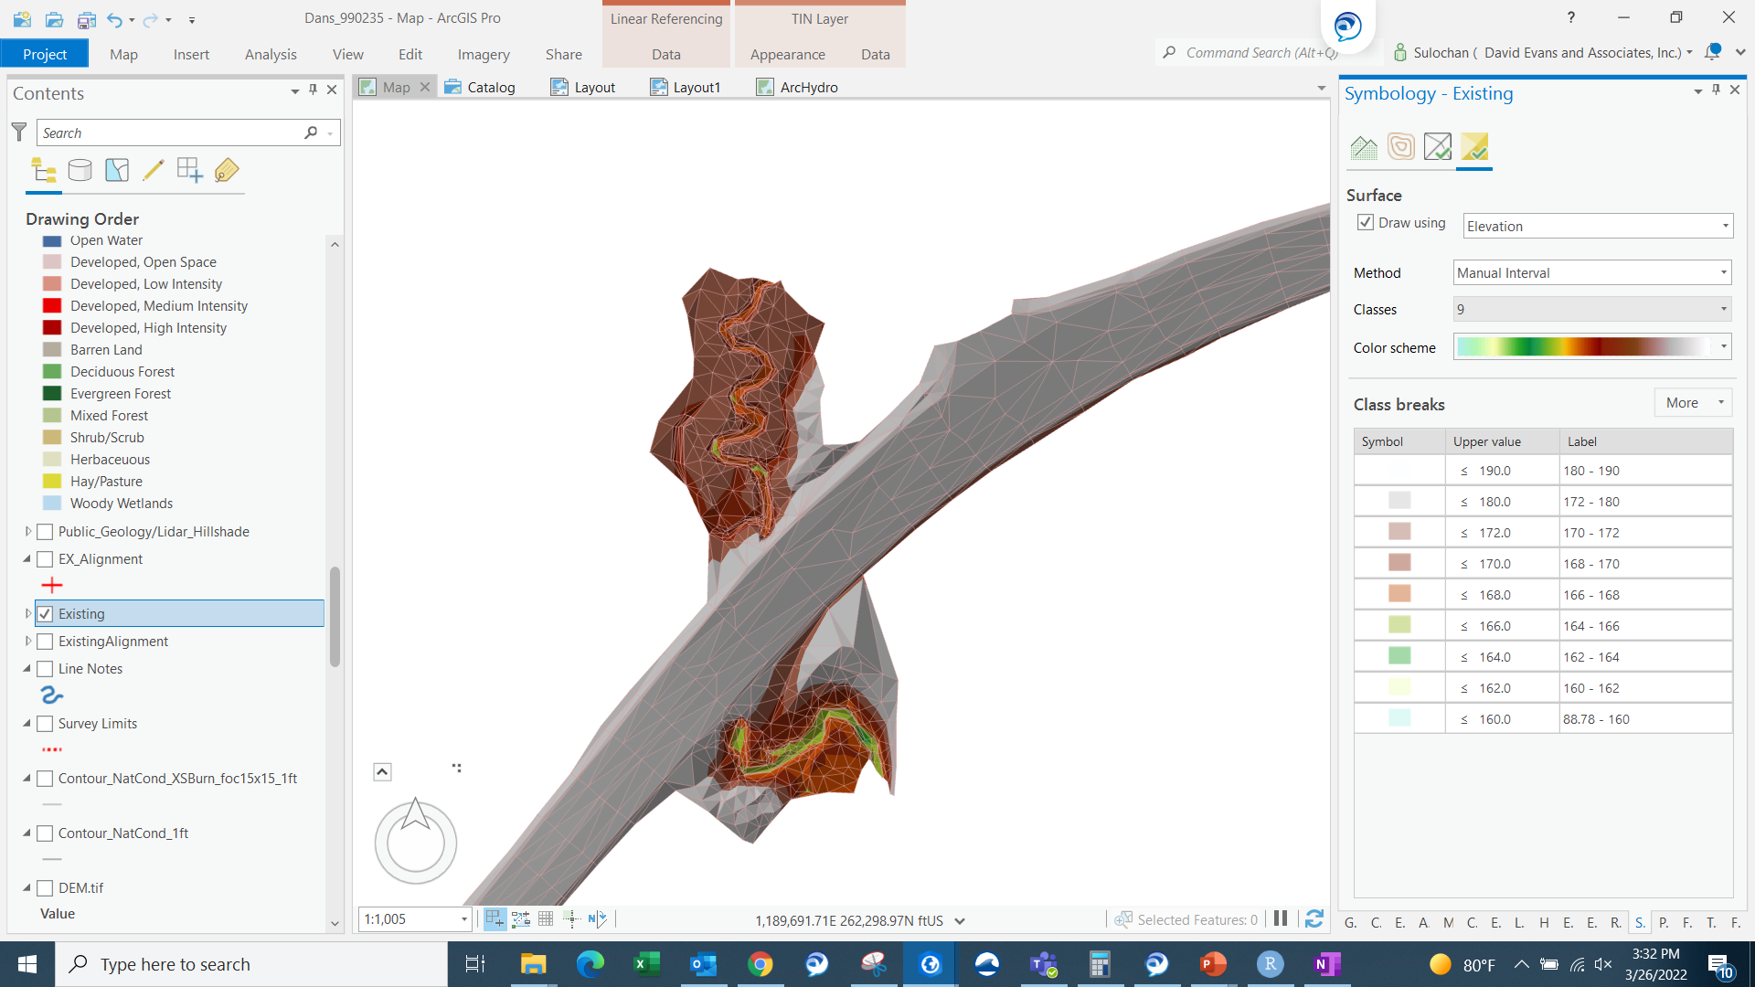
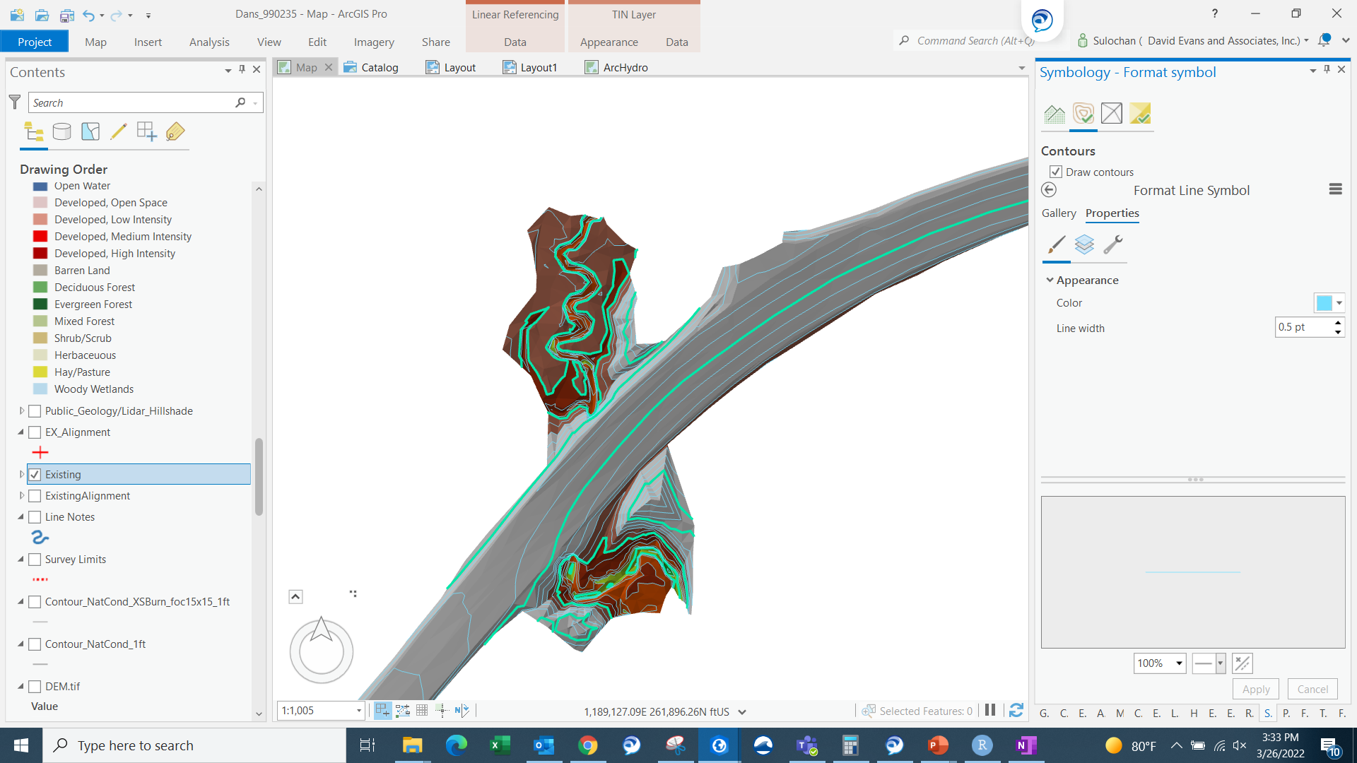
Terrain data (Contours)
Contours: Build using Triangular Irregular Network (TIN)
Survey or LIDAR
Points
Triangles
Surface
Contours
Notes:
We saw how watershed was delineated using contours.
We’ve seen contours – and usually in CAD, we see that they’re built using survey data and TINs

Slide 14
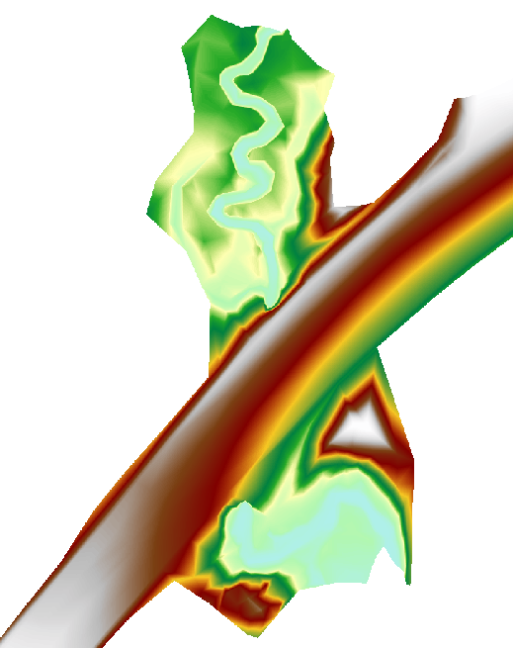
Terrain data (GRID/Raster)
Contours: Build using Triangular Irregular Network (TIN)
Survey or LIDAR
Points
Triangles
Surface
GRID/ Raster
Notes:
We saw how watershed was delineated using contours.
We’ve seen contours – and usually in CAD, we see that they’re built using survey data and TINs

Slide 15
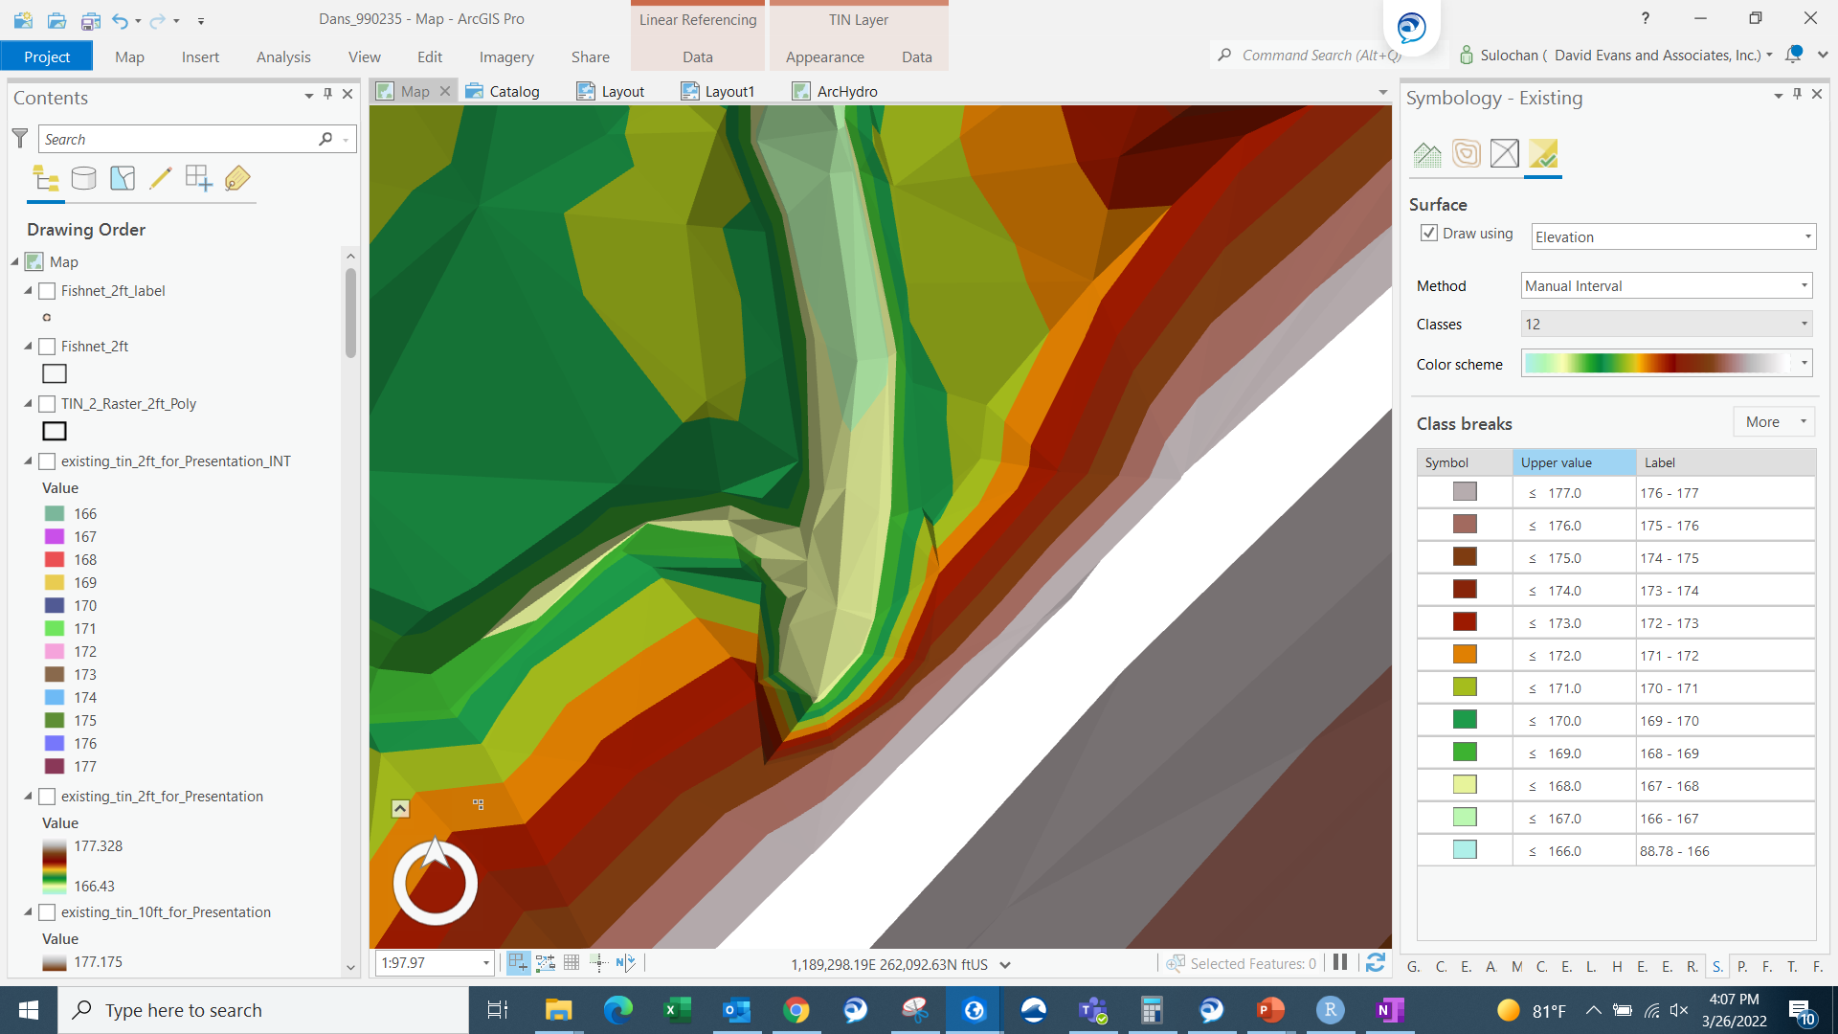
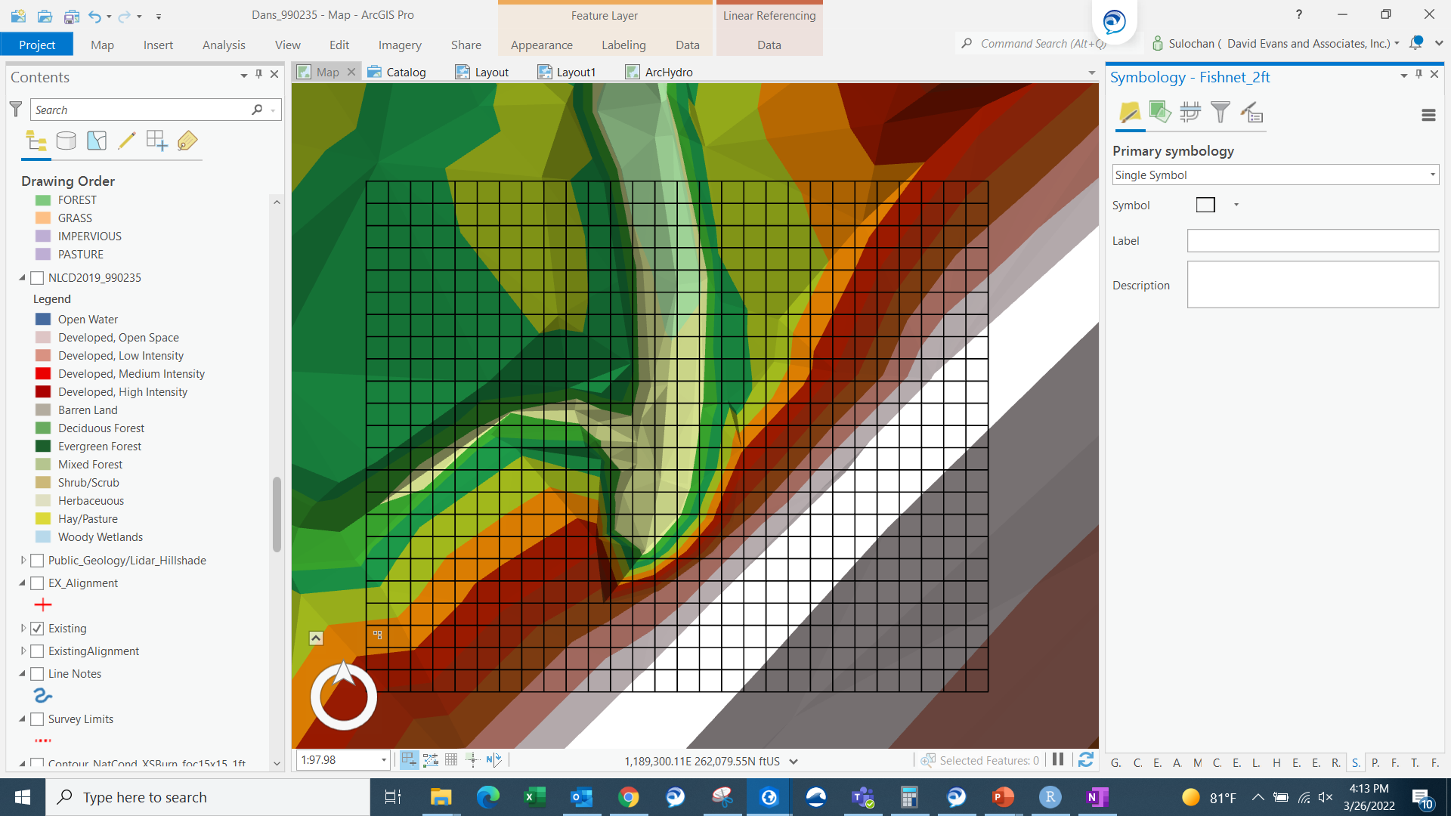
Terrain Data (GRID/Raster)
A grid is created over TIN surface

Slide 16
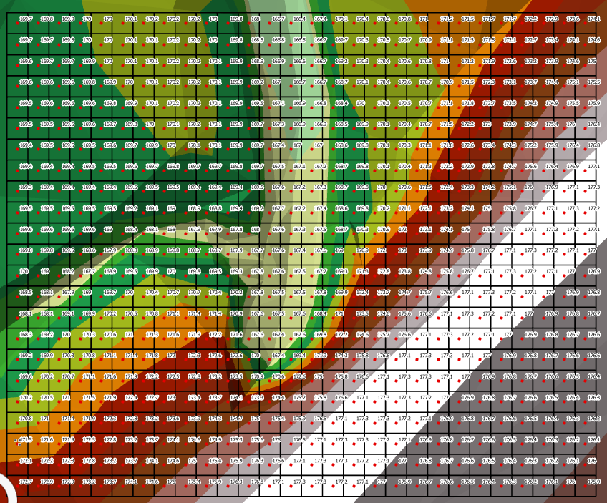
Terrain Data (Raster)
Elevation values from TIN surface within center of each grid are interpolated

Slide 17
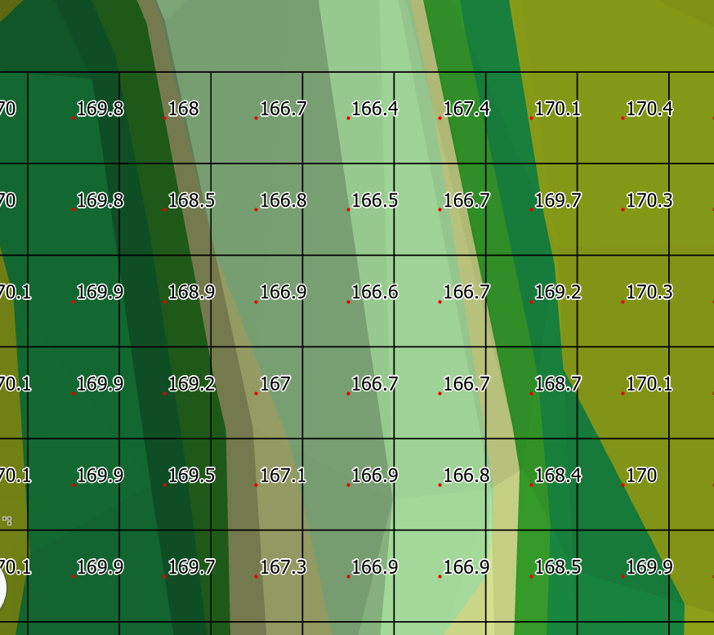
Terrain Data (Raster)
Elevation values from TIN surface within center of each grid are interpolated

Slide 18
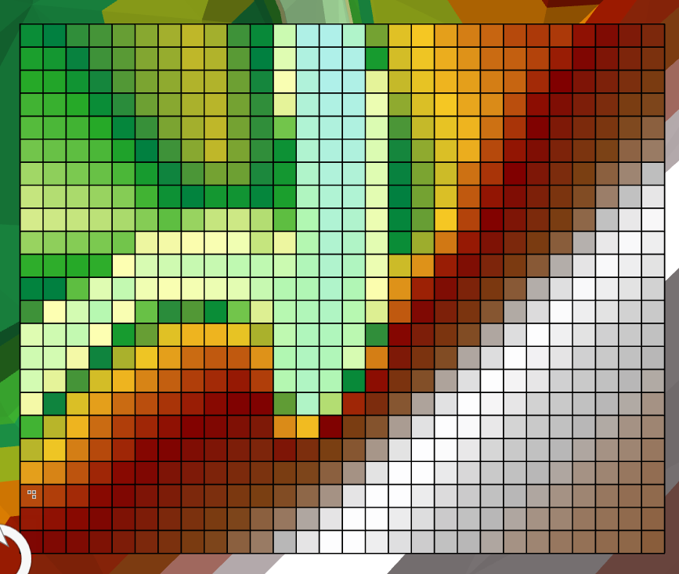
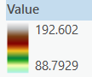
Terrain Data (Raster)
Visualization of raster is done based on the values

Slide 19
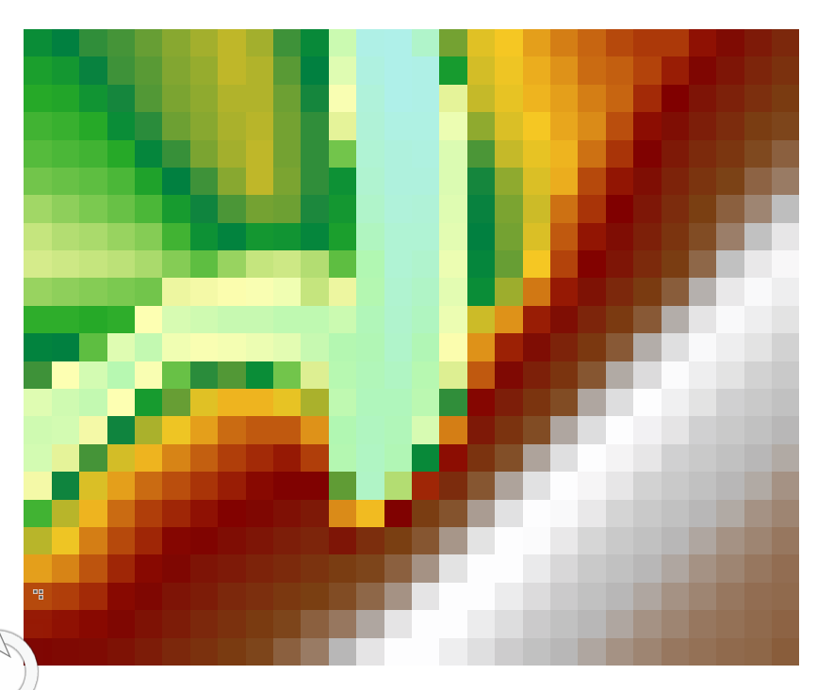
Terrain Data (Raster)
Visualization of raster is done based on the values
USGS, NOAA and other agencies produce and distribute these raster datasets. It can be downloaded and used directly in GIS.

Slide 20
Terrain analysis using GIS
Terrain raster is just a table of elevation values

Slide 21
Terrain analysis using GIS
Terrain raster is just a table of elevation values
(Let’s take a subset)
80
74
63
69
67
56
60
52
48

Slide 22
Terrain analysis using GIS
Terrain raster is just a table of elevation values
We want to figure out how a drop of water travels across the grid
80
74
63
69
67
56
60
52
48

Slide 23
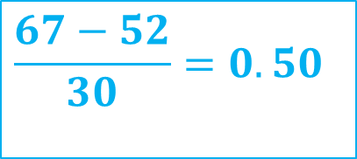
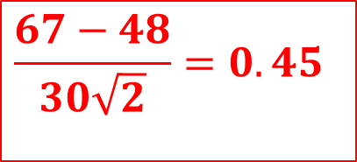
Terrain analysis using GIS
Terrain raster is just a table of elevation values
We want to figure out how a drop of water travels across the grid
30
80
74
63
69
67
56
60
52
48
$$\frac{67−48}{30\sqrt{2}}=0.45$$
$$\frac{67−52}{30}=0.50$$
Slope

Slide 24
Terrain analysis using GIS
Terrain raster is just a table of elevation values
We want to figure out how a drop of water travels across the grid
30
80
74
63
69
67
56
60
52
48
$$\frac{67−52}{30}=0.50$$
Steepest Slope

Slide 25
Terrain analysis using GIS
Terrain raster is just a table of elevation values
We want to figure out how a drop of water travels across the grid
The flow directions for all grid cells are determined.
Flow Direction Grid

Slide 26
Terrain analysis using GIS
Using the flow direction grid, a flow accumulation grid is created
0
0
2
2 cells draining

Slide 27
Terrain analysis using GIS
Using the flow direction grid, a flow accumulation grid is created
0
0
0
0
0
2
0
2
2
2 cells draining
2 cells draining

Slide 28
Terrain analysis using GIS
Using the flow direction grid, a flow accumulation grid is created
0
0
0
0
0
0
0
0
0
2
0
2
2
0
2
2
2
0
2 cells draining
2 cells draining
2 cells draining

Slide 29
Terrain analysis using GIS
Using the flow direction grid, a flow accumulation grid is created
0
0
0
0
0
0
2
2
2
0
10
6 cells accumulated
+
4 cells draining

Slide 30
Terrain analysis using GIS
The flow accumulation grid is created
0
0
0
0
0
0
0
0
0
0
0
2
2
2
0
0
2
2
2
0
0
10
0
1
0
10
1
0
0
14
0
0
4
1
19
1
6 cells accumulated
+
4 cells draining
Flow accumulation grid

Slide 31
Terrain analysis using GIS
The flow accumulation grid creates a network grid
0
0
0
0
0
0
0
0
0
0
0
0
0
0
0
0
2
2
2
0
0
2
2
2
0
0
2
2
2
0
10
0
1
0
0
0
1
0
10
0
10
1
0
0
14
0
1
0
0
0
14
0
4
1
19
1
0
4
1
1
19
6 cells accumulated
+
4 cells draining
Flow accumulation grid
Network grid
Notes:
This network grid is the basis of delineation of streams and catchments

Slide 32
Terrain analysis using GIS
Stream delineation – where does the streamline start from?

Slide 33
Terrain analysis using GIS
Define what a stream is based on flow accumulation
0
0
0
0
0
0
2
2
2
0
0
0
10
0
1
1
0
0
14
0
0
4
1
19
1

Slide 34
Terrain analysis using GIS
Define what a stream is based on flow accumulation
0
0
0
0
0
0
2
2
2
0
0
0
10
0
1
1
0
0
14
0
0
4
1
19
1
Assume Flow Accumulation > 10 Cell Threshold

Slide 35
Terrain analysis using GIS
Define what a stream is based on flow accumulation
Stream Network

Slide 36
Terrain analysis using GIS
Define what a stream is based on flow accumulation
Watershed
Outlet
Watershed

Slide 37
Terrain analysis using GIS
Define what a stream is based on flow accumulation
Watershed
Outlet
This process is repeated on the raster dataset using GIS

Slide 38
GIS Demo

Slide 39
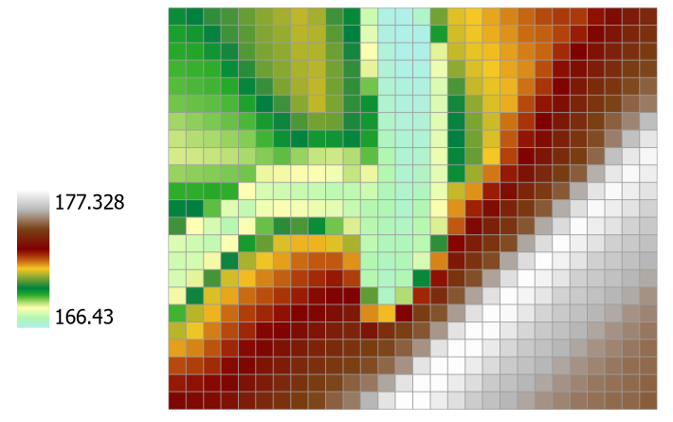
GIS Demo
Elevation

Slide 40
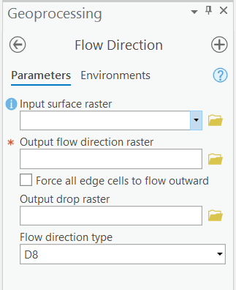
GIS Demo
Direction Encoding (D8)
32
64
128
16
1
8
4
2
The results are only 8 integer values representing each direction

Slide 41
GIS Demo
Direction Encoding (D8)
32
64
128
32
64
128
16
1
16
128
1
8
4
2
8
4
2
The results are only 8 integer values representing each direction

Slide 42
GIS Demo
Direction Encoding (D8)
32
64
128
32
64
128
16
1
16
1
8
4
2
8
4
2
The results are only 8 integer values representing each direction

Slide 43
GIS Demo
Direction Encoding (D8)
32
64
128
32
64
128
16
1
16
128
2
8
4
2
8
4
2
The results are only 8 integer values representing each direction

Slide 44
GIS Demo
Direction Encoding (D8)
32
64
128
32
64
128
16
1
16
1
8
4
2
8
4
2
The results are only 8 integer values representing each direction

Slide 45
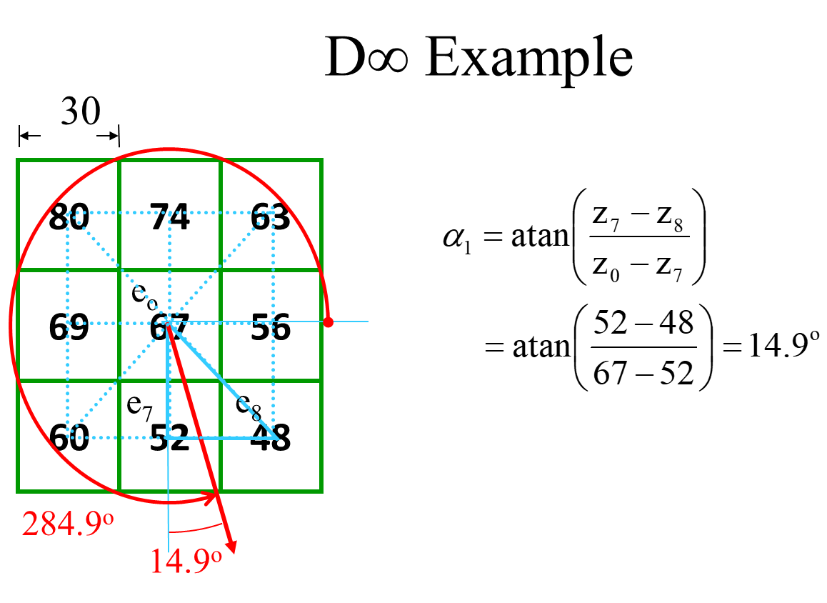
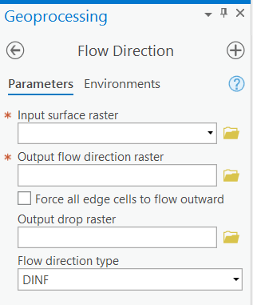
GIS Demo
Direction Encoding (DINF)
The results are angle value from east
‘Flow accumulation’ tool takes input from either D8 or DINF currently in ArcGIS
Notes:
MFD => Multiple Flow Direction => has potentially multiple values tied to each cell => Each value corresponds to proportion of flow to each downstream neighbor => not easily visualized
Drop Raster => Slope as percentage => ratio of the maximum change in elevation from each cell along the direction of flow to the path length between centers of cells, expressed in percentages.
Force all edge cells to flow outward => Since we can’t confirm the flow direction of edge cells, we can force all edge cells to outward
We will only work with D8 for most of hydrological analysis, although most of the subsequent analysis can be done using DINF also.

Slide 46
Back to GIS Demo

Slide 47
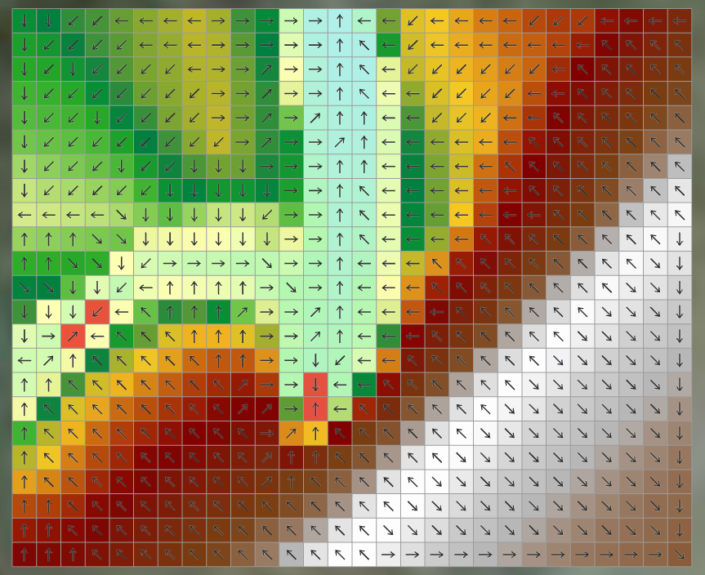
GIS Demo
Problem with Flow direction at certain cells
To remove those sinks we “Pit fill”

Slide 48
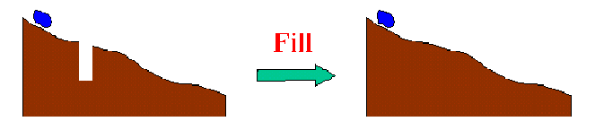
Pit Filling of Terrain
Local sinks are usually a problem when DEMs are created.
These sinks need to be filled before creating stream network since they can cause isolated watersheds.

Slide 49
Pit Filling of Terrain
Original DEM
There are pits where elevations is lower than surrounding cells
When flow direction and accumulation are calculated in these locations, the network delineation cannot propagate out of sink.
Pits OR Sinks

Slide 50
Pit Filling of Terrain
Pit Filling -> Increase elevation to the pour point elevation until the pit drains to a neighbor
Pit filling needs to be done before starting terrain analysis
Pour Points
The lowest grid cell adjacent to a pit

Slide 51
Back to GIS demo
Pit Filling
Flow Direction
Flow accumulation
Watershed
Stream-line delineation
5.1 CON (gt 50K)
5.2 Stream LINK
5.3 Watershed

Slide 52
Hydrologic processes are different on hillslopes and in channels. It is important to recognize this and account for this in the delineation of streams.
Drainage area can be concentrated or dispersed (specific catchment area) representing concentrated or dispersed flow.
So, threshold method is not always the best.
There are other ways to delineate network (1) Support area method or (2) Pueker Douglas

Slide 53
Back to GIS demo
Pit Filling
Flow Direction
Flow accumulation
Watershed
Stream-line delineation
5.1 CON (gt 50K)
5.2 Stream LINK
5.3 Watershed
5.4 Stream Order (Use link raster to preserve direction)

Slide 54
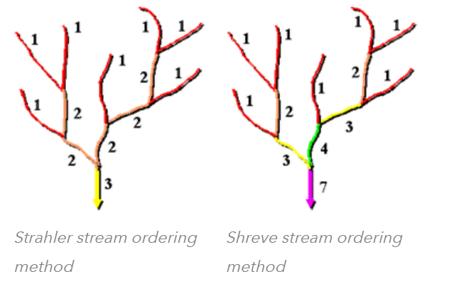
Stream Order
Method of assigning numeric order to stream links
Can be helpful in understanding some characteristics of stream
Example - First order streams are dominated by overland flows – most susceptible to non-point source pollution

Slide 55
Back to GIS demo
Pit Filling
Flow Direction
Flow accumulation
Watershed
Stream-line delineation
5.1 CON (gt 100K)
5.2 Stream LINK
5.3 Watershed
5.4 Stream Order (Use link raster to preserve direction)
5.5 Raster to Polyline
6. Delineate more sub-watersheds if needed

Slide 56
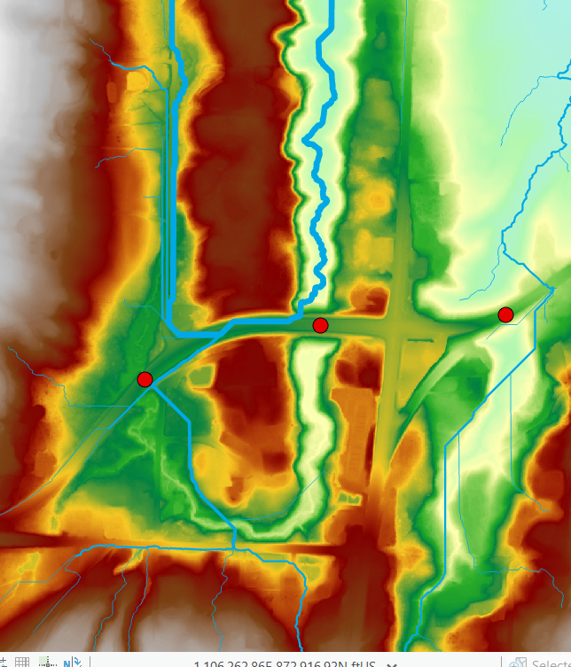
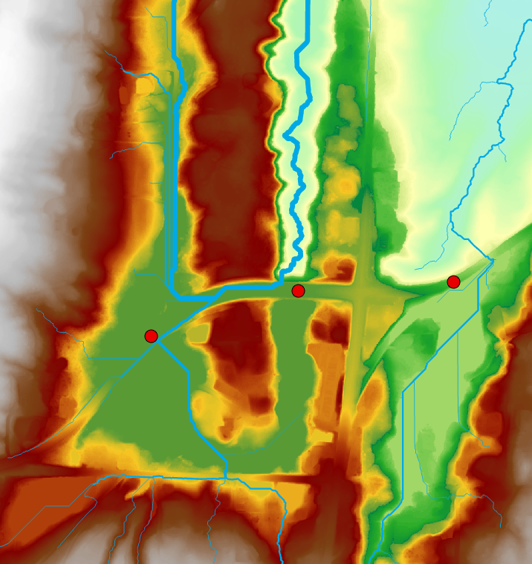
Fill Issue

Slide 57

Carving the DEM
Lower elevation of neighbor along a predefined drainage path until the pit drains to the outlet point
This has not been implemented in ArcGIS yet.

Slide 58
Carving
Original DEM
Pits
Notes:
Elevations are filled to that of the pools pour point

Slide 59
Carving
Original DEM
Carved DEM
Pits
Carve outlets
Notes:
Elevations are filled to that of the pools pour point

Slide 60
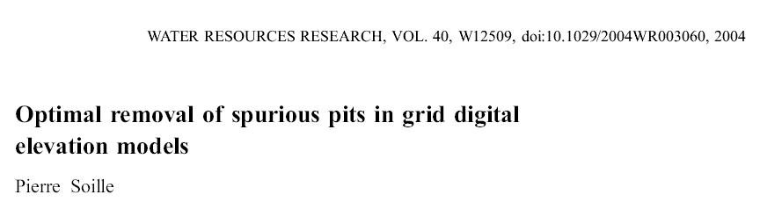
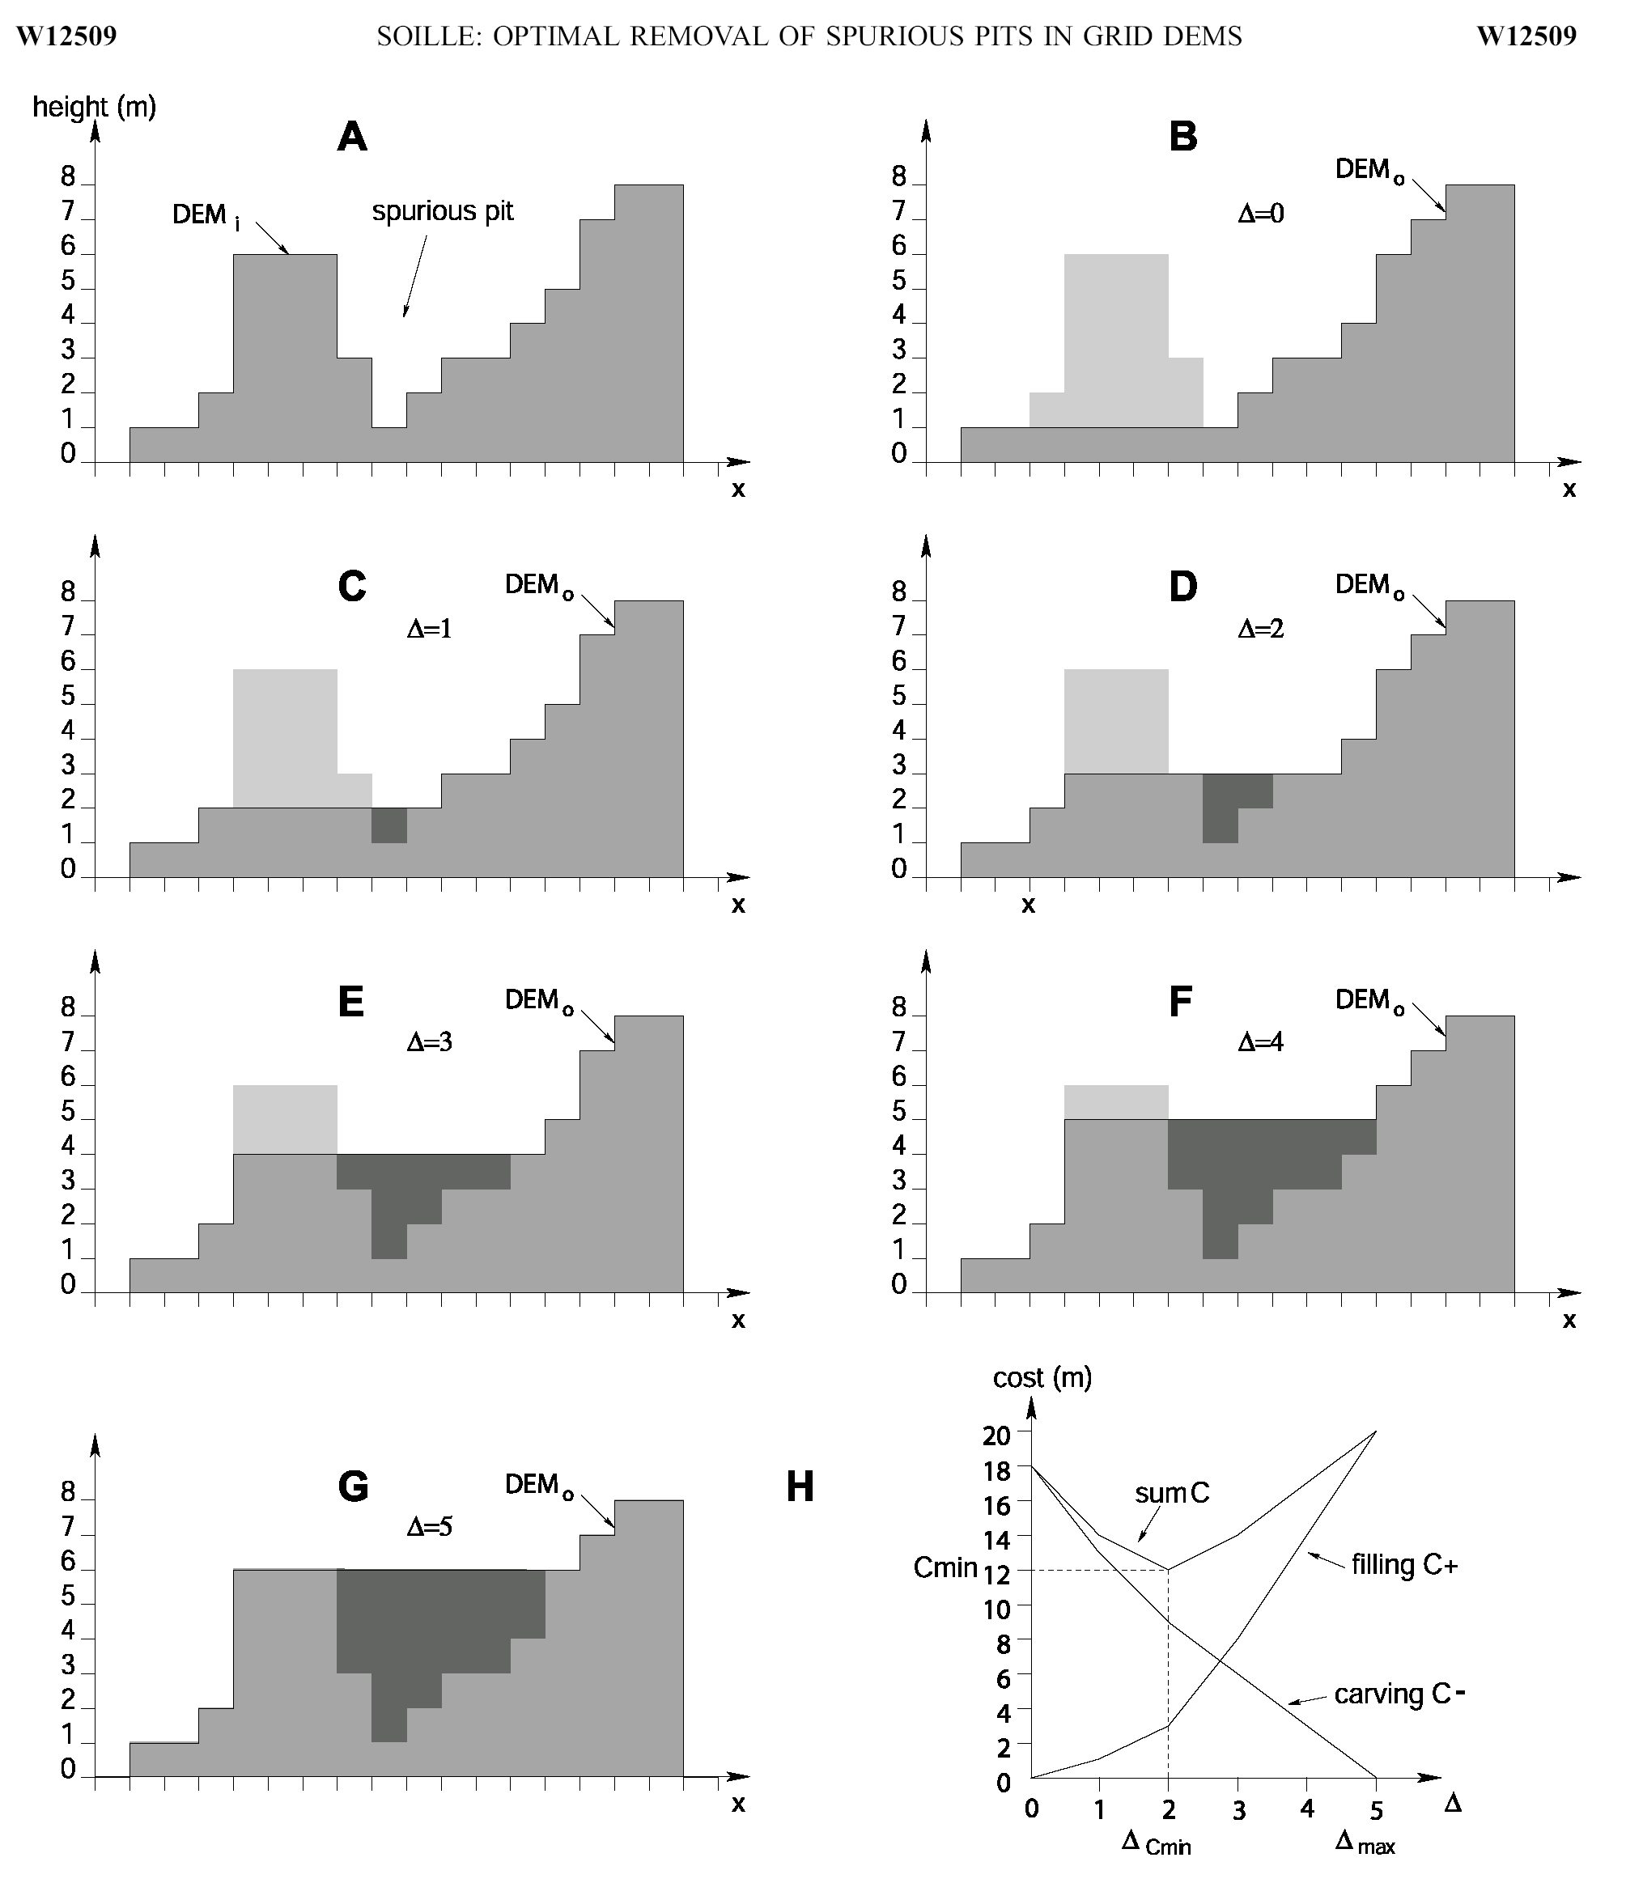
Filling
Minimizing Alterations
Carving

Slide 61
Minimizing DEM Alterations
Original DEM
Optimally adjusted
Carved
Pits
Filled
Notes:
Elevations are filled to that of the pools pour point

Slide 62
Carving the DEM
This has not been implemented in GIS

Slide 63
GIS DEMO
Snap Pour Point (Grabs the point with highest flow accumulation within specified radius)
100 feet
Network creation
Feature dataset
Create Trace network – edge flow lines
Enable Network topology
Validate Network Topology

Slide 64
Thank you!

